Slide 1
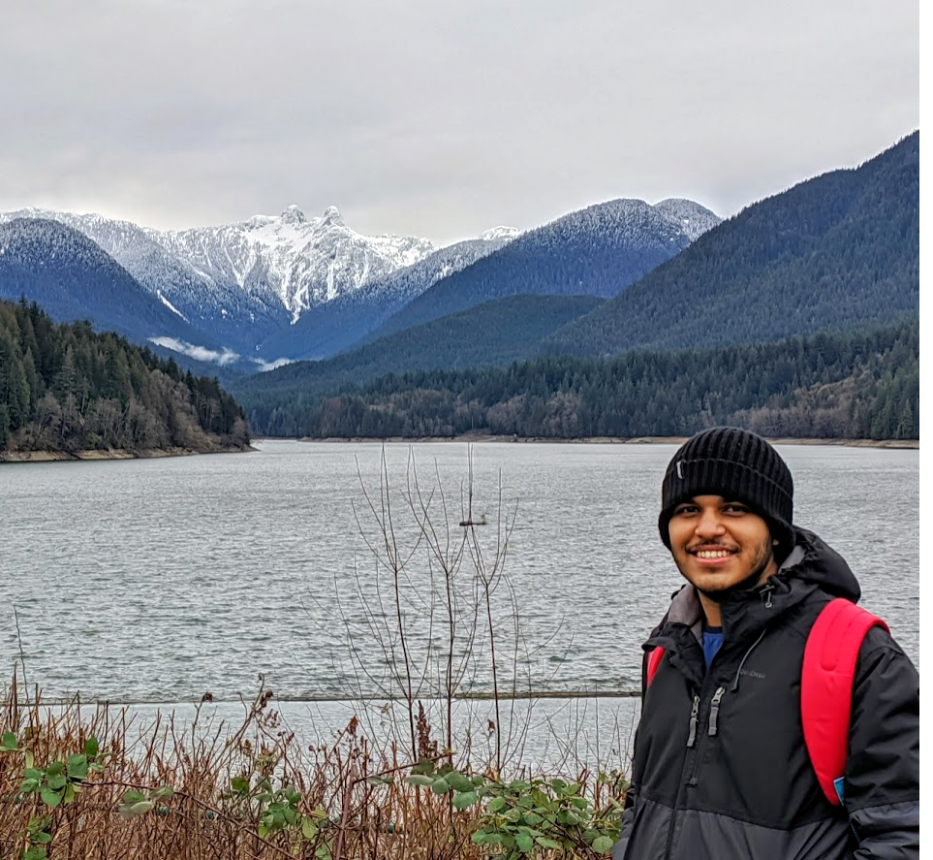
Stephen Joy 300329148
1

Slide 2


Background
Born in Kerala, India
Grew up in Mumbai, India

Slide 3
Timeline
Bachelor’s in Science – Information Technology
Mumbai University
(May 2019)
Web Application Developer
Nexdigm Group
(October 2019 – November 2020)
Developed multiple web-based audit applications for internal as well as external clients. Used technologies such as PHP Laravel, JavaScript, jQuery, Ajax, HTML, CSS as frontend and MongoDB as backend.
Computer and Information System: Data Analytics
Douglas College
(Jan 2021 – December 2022)

Slide 4




Course
CSIS 1175
Introduction to Programming
CSIS 1280
Multimedia Web Development
Computer and Information Systems: Data Analytics
1st Semester
CSIS 2200
System Analysis and Design
CSIS 2260
Operating Systems

Slide 5






My hobbies and Interests
Playing Football
Cycling
Gaming
Music
Films
Reading

Slide 6

Education Goals
Complete CSIS
degree
Learn about emerging technologies
Learn AI / ML
1
2
3
My top three educational goals

Slide 7
Career Goals
Becoming an expert in web / software development
Switch career to AI/ML
Starting my own business
1
2
3
My top three career goals

Slide 8
Skills
Soft Skills
Problem solving
Open-mindedness
Creative
Adaptive
Organization
Hard Skills
UI / UX Designing
Programming languages (PHP, JavaScript, C#, Python)
Database Management (MySQL, SQL, MongoDB)
Android Application Development

Slide 9
Fin

